Slide 1
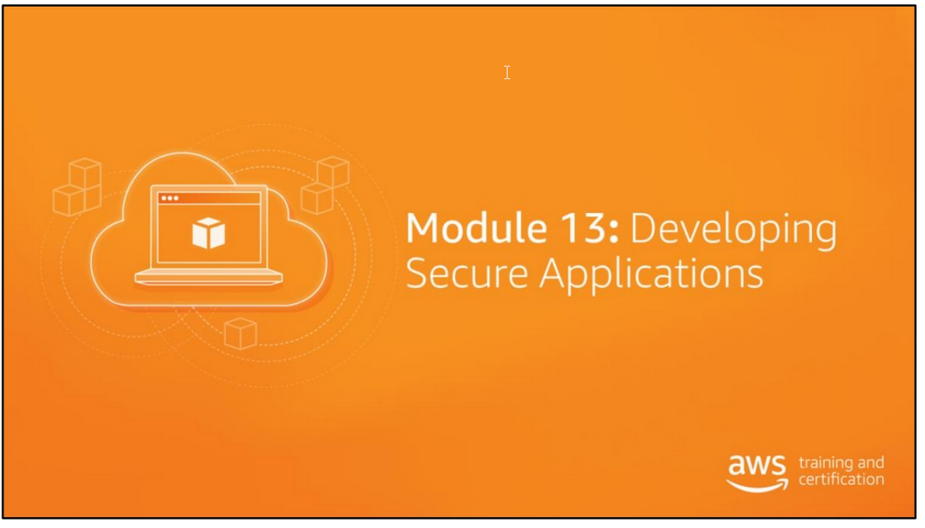

Slide 2
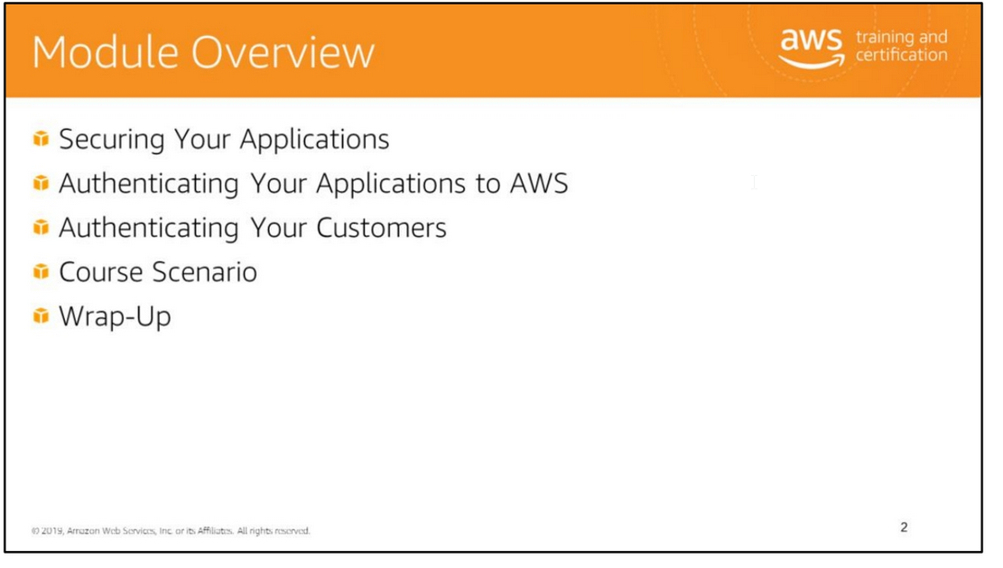

Slide 3


Slide 4
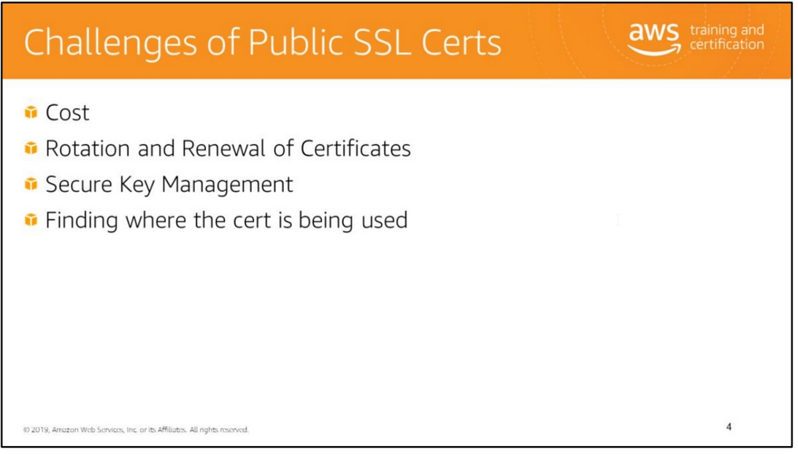

Slide 5
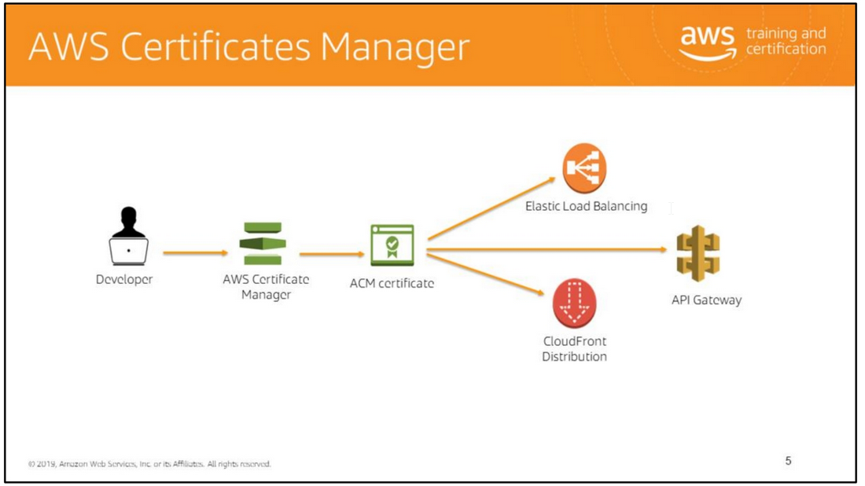
AWS Certificate Manager (ACM) is a service that lets you easily provision, manage, and deploy public and private Secure Sockets Layer/Transport Layer Security (SSL/TLS) certificates for use
with AWS services and your internal connected resources.
SSL/TLS certificates are used to secure network communications and establish the identity of websites over the internet as well as resources on private networks.
ACM removes the time-consuming manual process of purchasing, uploading, and renewing SSL/TLS certificates.
With ACM, you can quickly request a certificate, deploy it on ACM-integrated AWS resources, such as Elastic Load Balancing, Amazon CloudFront distributions, and APIs on API Gateway,
and let ACM handle certificate renewals. It also enables you to create private certificates for your internal resources and manage the certificate lifecycle centrally.
Public and private certificates provisioned through ACM for use with ACM-integrated services are free.
You pay only for the AWS resources you create to run your application. For private certificates, you pay monthly for the operation of the private CA and for the private certificates you issue.

Slide 6
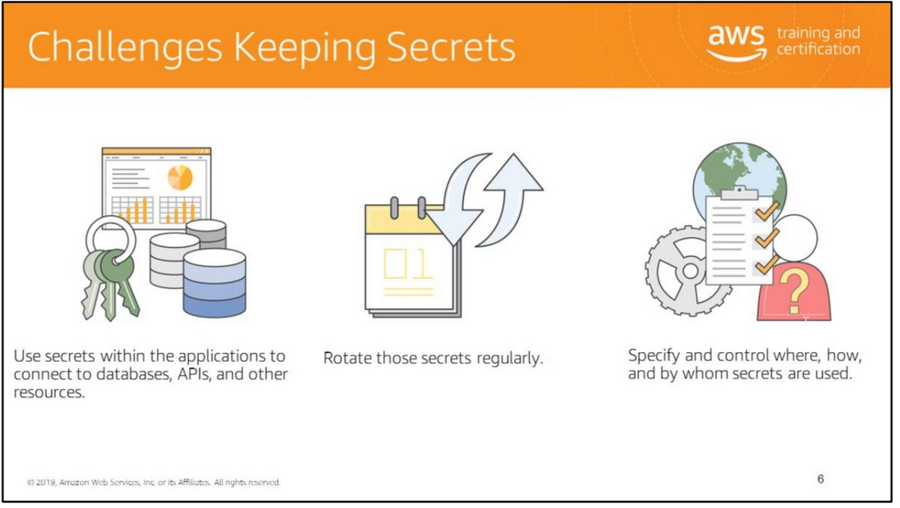
Some challenges around managing secrets:
• Apps use secrets, but you don’t want to write plaintext secrets in source code or environment variables.
• Organizations move to a service-oriented architecture and need a reliable mechanism to deliver these secrets to their services.
• Customers also wanted to rotate these secrets regularly to meet compliance needs or improve security. For example, PCI requires that secrets be rotated every 30 days.
• An employee who left the company 6 months ago but his laptop still had the password for the database.
• Also control who can do what with their secrets.

Slide 7
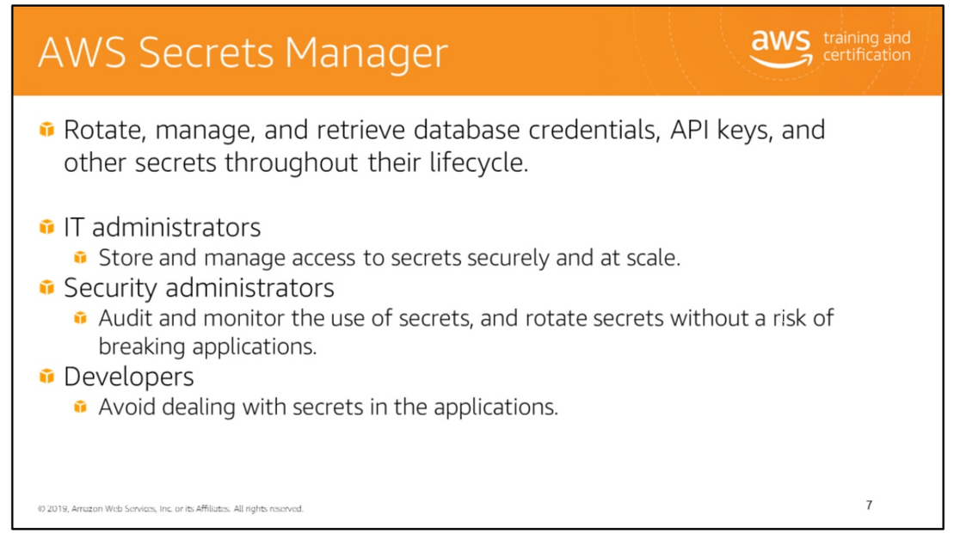
AWS Secrets Manager helps you protect secrets needed to access your applications, services, and IT resources.
The service enables you to easily rotate, manage, and retrieve database credentials, API keys, and other secrets throughout their lifecycle.
Users and applications retrieve secrets with a call to Secrets Manager APIs, eliminating the need to hardcode sensitive information in plaintext.
Secrets Manager offers secret rotation with built-in integration for Amazon RDS for MySQL, PostgreSQL, and Amazon Aurora.
The service is extensible to other types of secrets, including API keys and OAuth tokens.
Secrets Manager enables you to control access to secrets using fine-grained permissions and audit secret rotation centrally for resources in the AWS Cloud, third-party services, and on-premises.

Slide 8
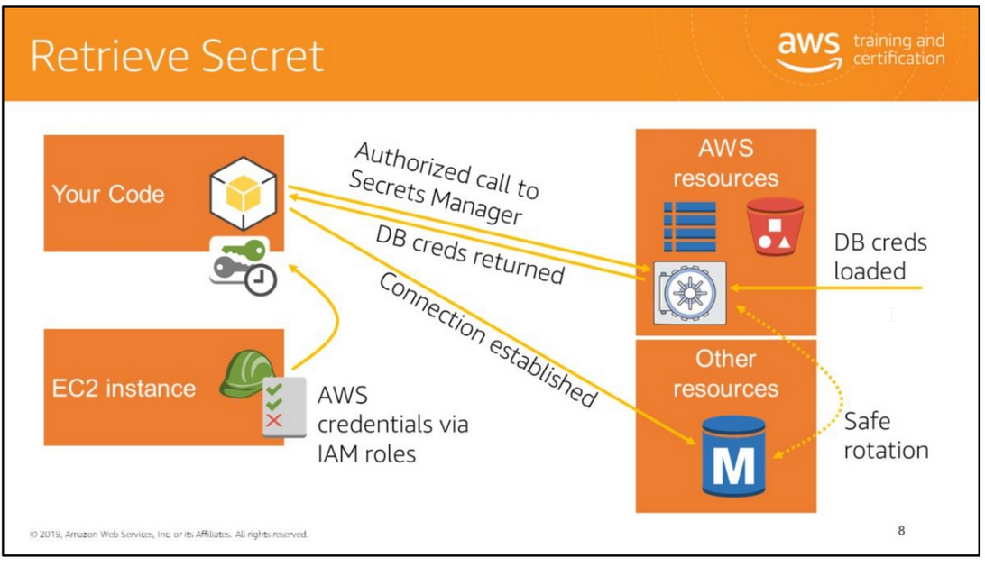
In this scenario, no human being ever touches the secret or sees it in plaintext.
Combo provides your apps a reliable, secure, auto-rotating solution for ALL credentials.

Slide 9


Slide 10
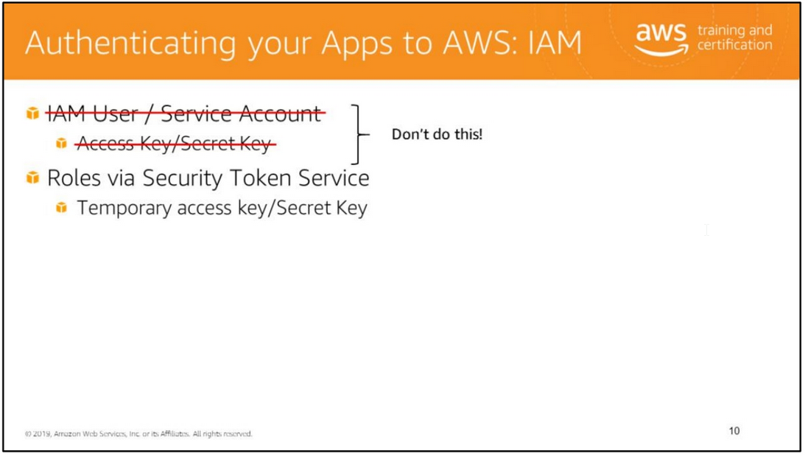

Slide 11
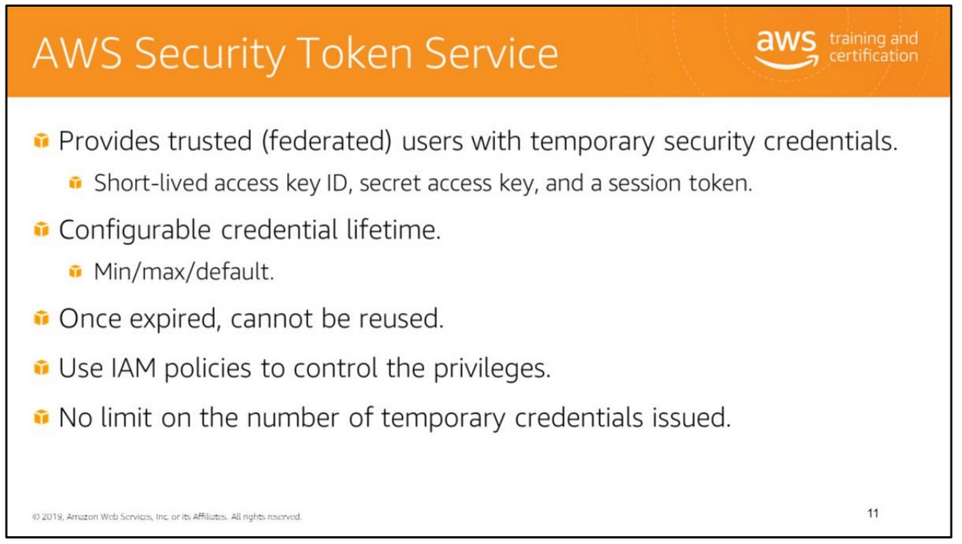
The AWS Security Token Service (AWS STS) enables you to provide trusted (federated) users with temporary credentials that provide controlled access to your AWS resources.
These credentials can be used to sign in to the AWS Management Console or to make AWS API requests.
Temporary security credentials consist of a short-lived access key ID, a secret access key, and a session token.
The temporary security credentials have a limited (3600 seconds, by default) and configurable lifetime.
You can specify how long the credentials are valid. After they expire, they cannot be reused. You do not have to rotate them or explicitly revoke them when they’re no longer needed.
Some AWS STS APIs allow you to pass information about a multi-factor authentication (MFA) device.
This lets you make sure that the temporary security credentials that result from the API call can be used only by users who have authenticated with an MFA device
To support SSO, AWS lets you call a federation endpoint, passing temporary security credentials.
The endpoint returns a token that can be used to construct a URL that signs a user directly into the console without requiring a password.

Slide 12
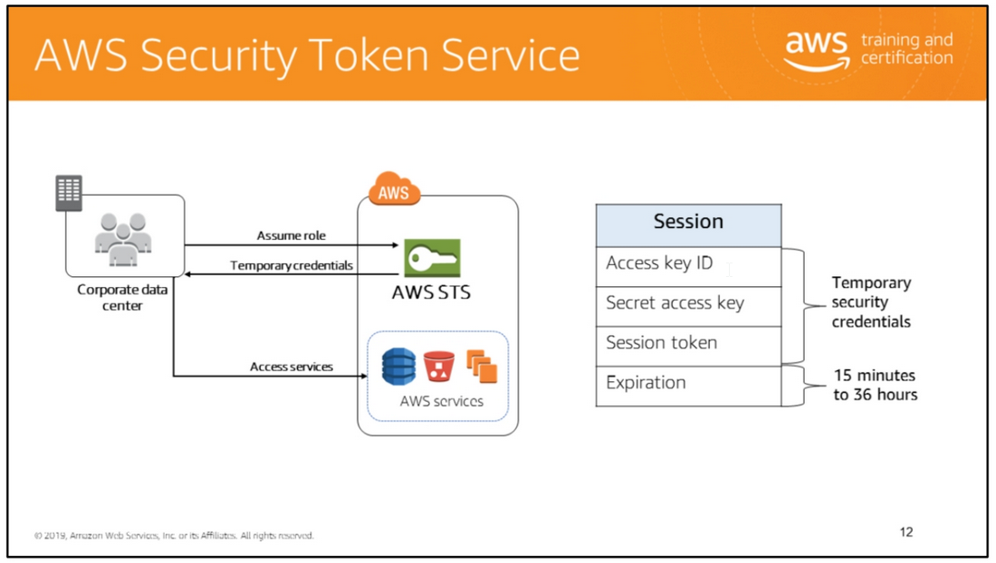

Slide 13
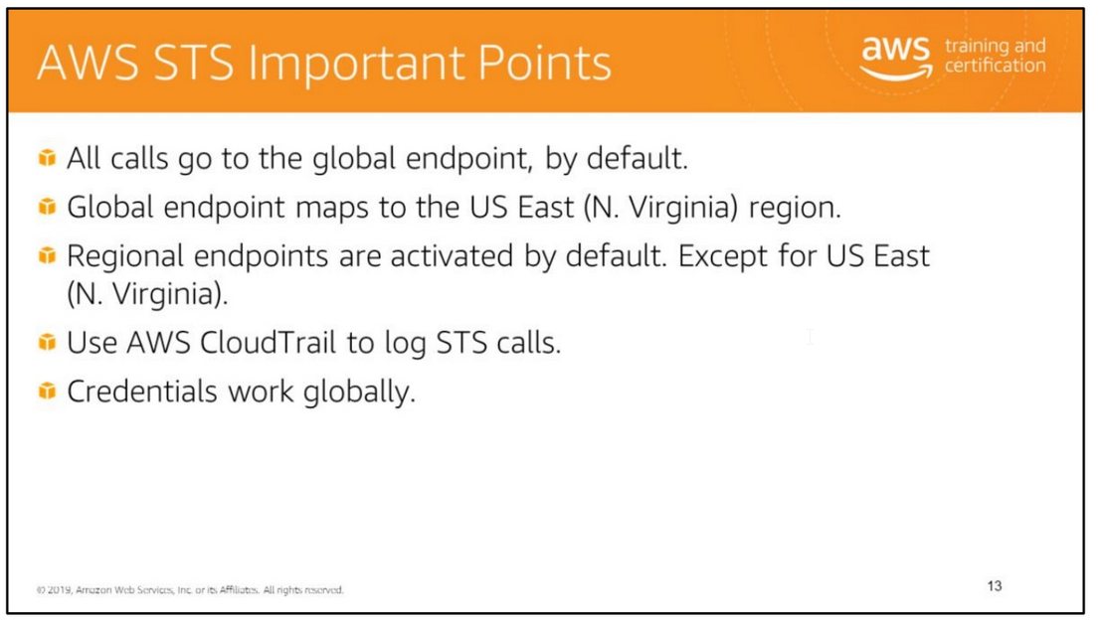
By default, AWS Security Token Service (AWS STS) is available as a global service, and all AWS STS requests go to a single endpoint.
Here are some important points:
• All calls go to the global endpoint, by default.
• Global endpoint maps to the US East (N. Virginia) region.
• Regional endpoints are activated by default. Except for US East (N. Virginia).
• Use AWS CloudTrail to log STS calls.
• Credentials work globally.
You can choose to send your AWS STS requests to a regional endpoint for the following reasons:
Reduce latency
By making your AWS STS calls to an endpoint that is geographically closer to your services and applications, you can access AWS STS services with lower latencies.
Build in redundancy
By adding code to your application that switches your AWS STS API calls to a different region, you ensure that if the first region stops responding for any reason,
your application is more fault-tolerant and continues to operate.
Before you can use an AWS STS endpoint in a different region, you must activate AWS STS in that region for your AWS account.

Slide 14
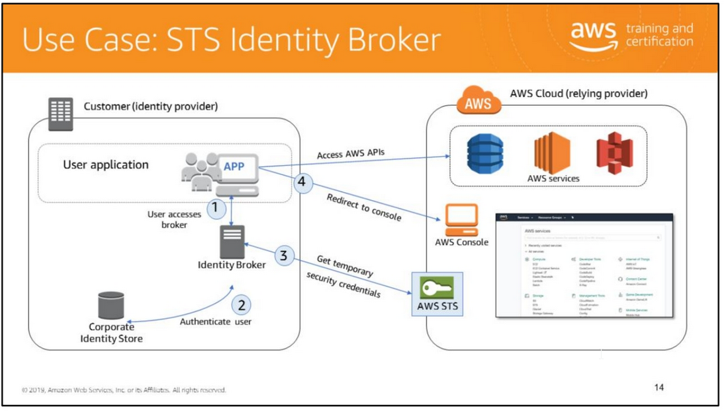
In this scenario:
• The identity broker application has permissions to access the AWS STS API to create temporary security credentials.
• The identity broker application is able to verify that employees are authenticated within the existing authentication system.
• Users are able to get a temporary URL that gives them access to the AWS Management Console (which is referred to as single sign-on). IAM user groups from another AWS account
You can establish cross-account access by using IAM roles.
Using roles for cross-account access lets you grant access to any resources that the trusting account (Account A) has access to, as long as the resource is in a service that supports roles.
IAM users within the current account:
For mission-critical permissions that IAM users might not frequently use, you can separate those permissions from their normal day-to-day permissions by using roles.
Users would then have to actively assume a role, which can prevent them from accidentally performing disruptive actions.
For example, you might have Amazon EC2 instances that are critical to your organization.
Instead of directly granting administrators permission to terminate the instances, you can create a role with those privileges and allow administrators to assume the role.

Slide 15
Administrators won't have permission to terminate those instances; they must first assume a role.
By using a role, administrators must take an additional step to assume a role before they can stop an instance that's critical
to your organization.
Third Parties:
When third parties require access to your organization's AWS resources, you can use roles to delegate API access to them.
For example, a third party might provide a service for managing your AWS resources.
With IAM roles, you can grant these third parties access to your AWS resources without sharing your AWS security credentials.
Instead, they can assume a role that you created to access your AWS resources.
Third parties must provide you the following information for you to create a role that they can assume:
• The AWS account ID that the third party's IAM users use to assume your role.
You specify their AWS account ID when you define the trusted entity for the role.
• An external ID that the third party can associate with your role.
You specify the ID that was provided by the third party when you define the trusted entity for the role.
• The permissions that the third party requires in order to work with your AWS resources.
You specify these permissions when defining the role's permission policy.
This policy defines what actions they can take and what resources they can access.
• After you create the role, you must share the role's Amazon Resource Name (ARN) with the third party.
They require your role's ARN in order to assume the role.
Identity Broker:
• Used to query AWS STS
• Determines user from a web request
• Uses AWS credentials (service account) to authenticate to AWS
• Issues temporary security credentials to access AWS APIs (through STS)
• AWS permissions are configured by the administrator of the identity broker
• Configurable timeout; 1–36 hours
• Sample IIS authentication proxy code provided →
http://aws.amazon.com/code/128865309919019

Slide 16
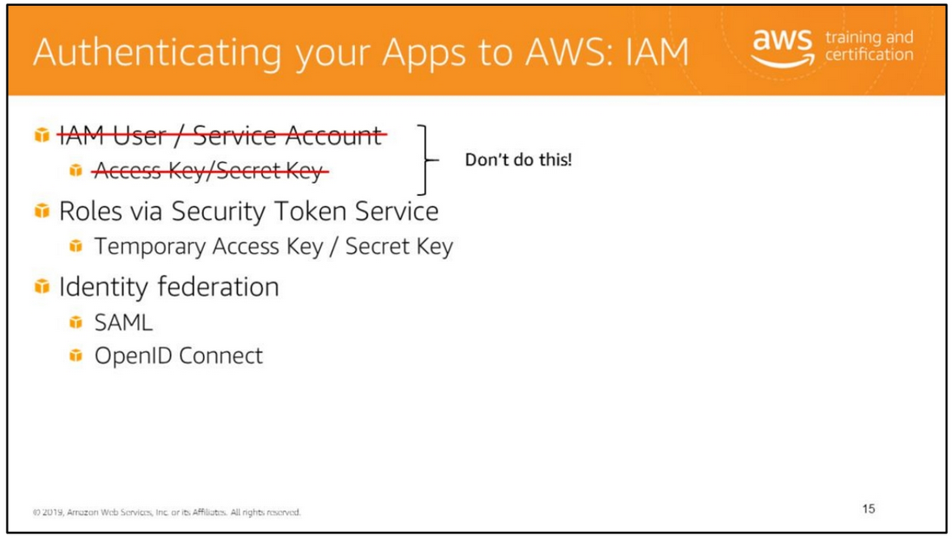

Slide 17
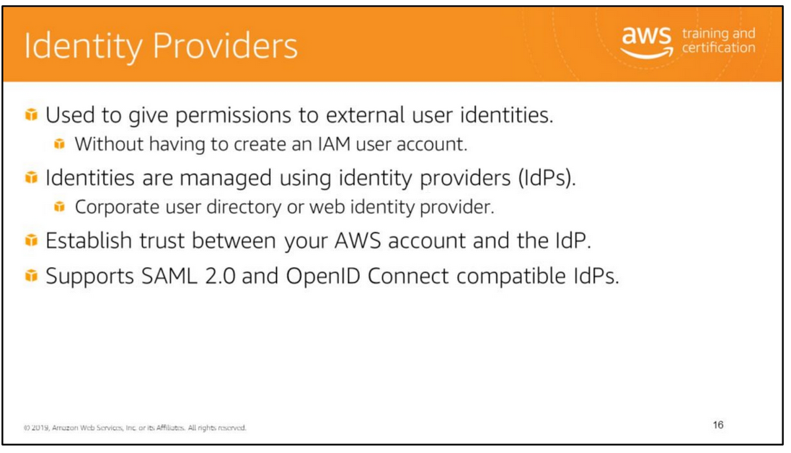
As an alternative to creating IAM users in your AWS account, IAM lets you use identity providers.
Using identity providers, you can manage user identities outside of AWS, and you can give these external user identities (federated users) permissions to use AWS resources in your account.
This is useful if your organization has its own identity system, such as a corporate user directory (for example, Microsoft Active Directory or AWS Directory Service).
It is also useful if you are creating a mobile app or web application that requires access to AWS resources.
When you use an identity provider, you don't have to create custom sign-in code or manage your own user identities.
Instead, users of your app can sign in using a well-known identity provider, such as Amazon Cognito, Login with Amazon, Facebook, or Google, and you can give permissions
to use AWS resources in your account to that external identity.
Using an identity provider helps you keep your AWS account secure, because you don't have to distribute long-term security credentials, such as IAM user access keys, with your application.
To use an identity provider, create an IAM identity provider entity to establish trust between your AWS account and the external identity provider.
IAM supports identity providers that are compatible with SAML 2.0 (Security Assertion Markup Language 2.0) or with OpenID Connect (OIDC)

Slide 18
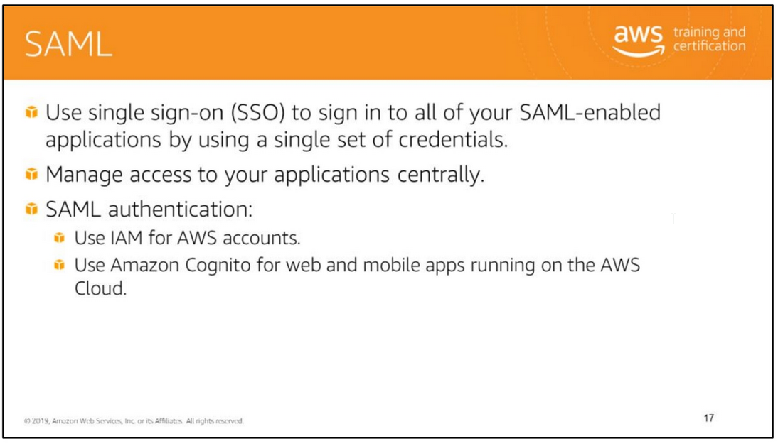
Security Assertion Markup Language 2.0 (SAML) is an open standard for exchanging identity and security information with applications and service providers.
Applications and service providers that support SAML enable you to sign in using your corporate directory credentials, such as your user name and password from Microsoft Active Directory.
With SAML, you can use single sign-on (SSO) to sign in to all of your SAML-enabled applications by using a single set of credentials.
SAML-enabled applications delegate authentication requests to your corporate directory. When users are removed from your directory, they are no longer able to sign in.

Slide 19
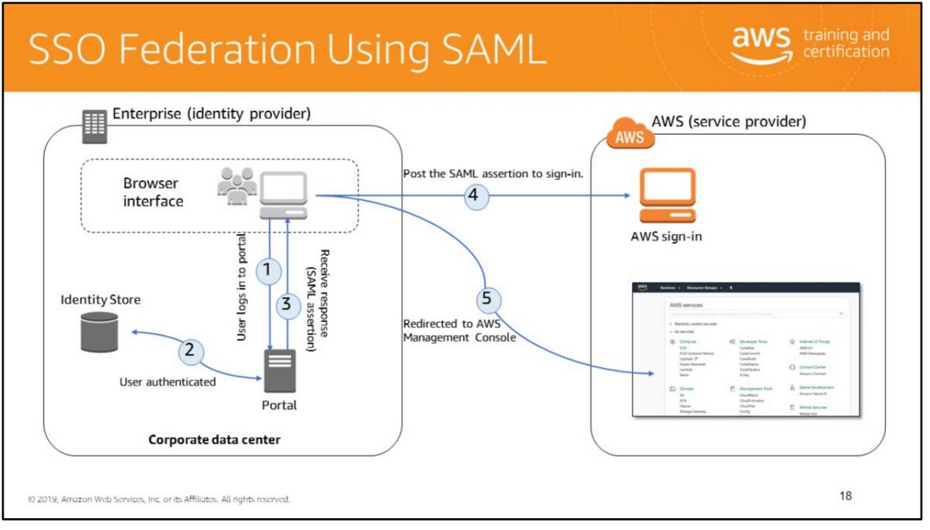
User browses to a URL: A user in your organization browses to an internal portal in your network.
The portal also functions as the IdP that handles the SAML trust between your organization and AWS.
2. User authenticated: The identity provider (IdP) authenticates the user’s identity against AD.
3. Receives authentication response: The client receives a SAML assertion (in the form of authentication response) from the IdP.
4. Post to sign-in passing AuthN: The client posts the SAML assertion to the new AWS sign-in endpoint.
Behind the scenes, sign-in uses the AssumeRoleWithSAML API to request temporary security credentials and construct a sign-in URL.
5. Redirect client to AWS Management Console: The user’s browser receives the sign-in URL and is redirected to the AWS Management Console.
From the user’s perspective, the process happens transparently.
The user starts at your organization’s internal portal and ends up at the AWS Management Console without ever having to supply any AWS credentials.
The basic steps:
Generate a metadata document using your IdP software.
2. Create a SAML provider using that metadata document.
3. Create one or more IAM roles that establish trust with the SAML provider and define permissions for the federated user.
4. Configure your IdP software to map attributes (such as AD groups) to the IAM roles.
5. Finished

Slide 20
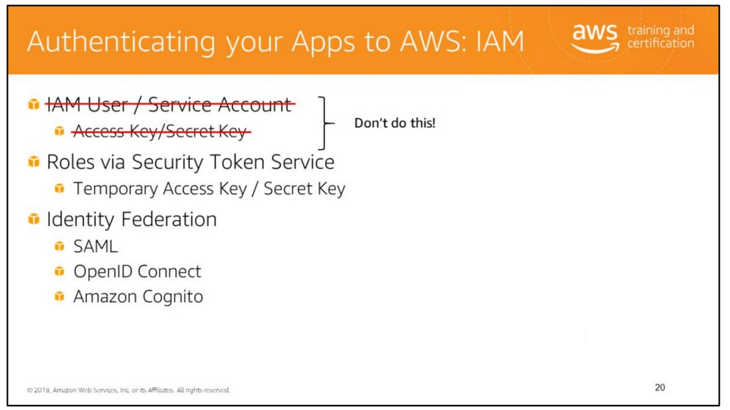

Slide 21
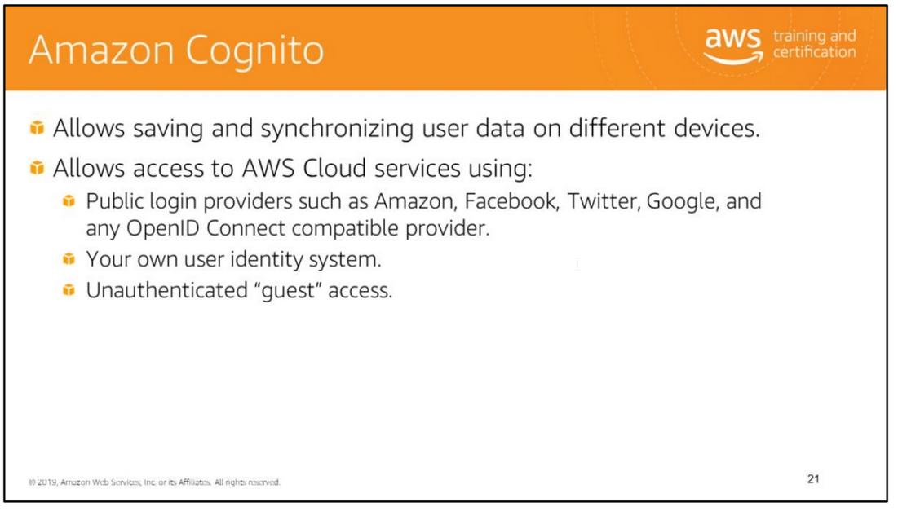
Amazon Cognito is a service that makes it easy to save mobile user data, such as app preferences or game state,
in the AWS Cloud without writing any backend code or managing any infrastructure.
Amazon Cognito offers mobile identity management and data synchronization across devices.
You can save data locally on users’ devices that allows your applications to work even when the devices are offline.
You can also synchronize data across a user’s devices so that their app experience will be consistent regardless of the device they use.
Amazon Cognito simplifies the way your application can access AWS resources in a secure manner, following AWS security best practices, even when your application users are not authenticated.
Amazon Cognito creates a random, unique identifier for each unauthenticated guest so you can start saving application data for those users and also leverage the temporary,
limited privilege credentials Amazon Cognito provides to access other AWS resources, such as Amazon S3 and Amazon DynamoDB.
When your users decide to authenticate using one of the supported public login providers, Amazon Cognito ensures that the data you saved against the unauthenticated profile
is now associated with the new authenticated profile, thus removing the complexity of managing user conversion.
By registering an unauthenticated user or by sending a login provider token to Amazon Cognito, your application receives a set of temporary, limited privilege credentials
from Amazon Cognito to access your AWS resources.
Amazon Cognito takes care of all the steps necessary to create a unique identifier for your app’s users and retrieve the AWS credentials.

Slide 22
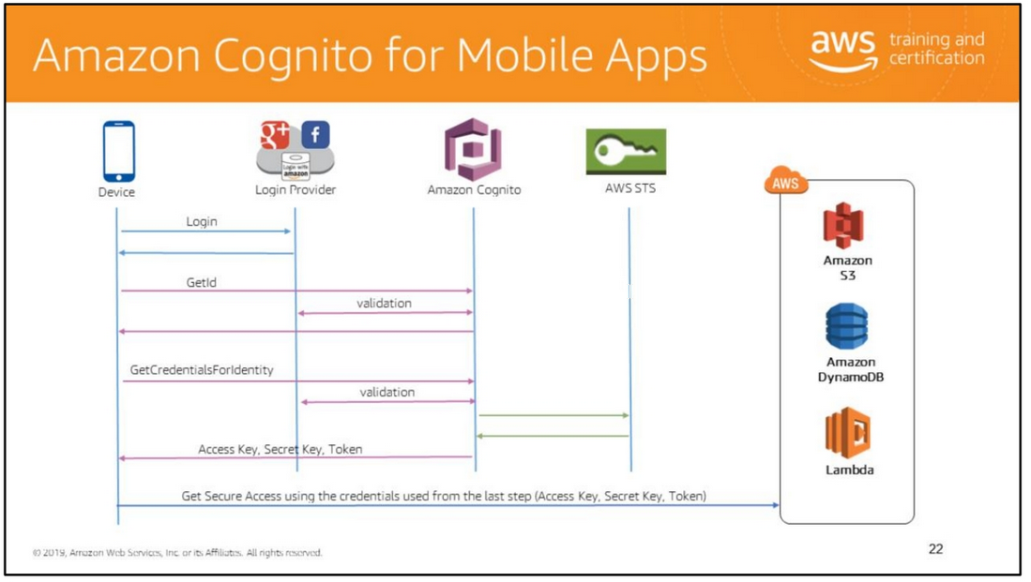
Amazon Cognito helps you create unique identifiers for your end users that are kept consistent across devices and platforms.
Amazon Cognito also delivers temporary, limited-privilege credentials to your application to access AWS resources.
A user authenticating with Amazon Cognito will go through a multi-step process to bootstrap their credentials.
Enhanced (Simplified) Authflow
• GetId - The GetId API call is the first call necessary to establish a new identity in Amazon Cognito.
• Generates (or retrieves) a Cognito ID. Supplying multiple logins will create an implicit linked account.
• GetCredentialsForIdentity - The GetCredentialsForIdentity API can be called after you establish an identity ID.
• Returns credentials for the provided identity ID. Any provided logins will be validated against supported login providers.
If the token is for cognito-identity.amazonaws.com, it will be passed through to AWS Security Token Service with the appropriate role for the token.

Slide 23
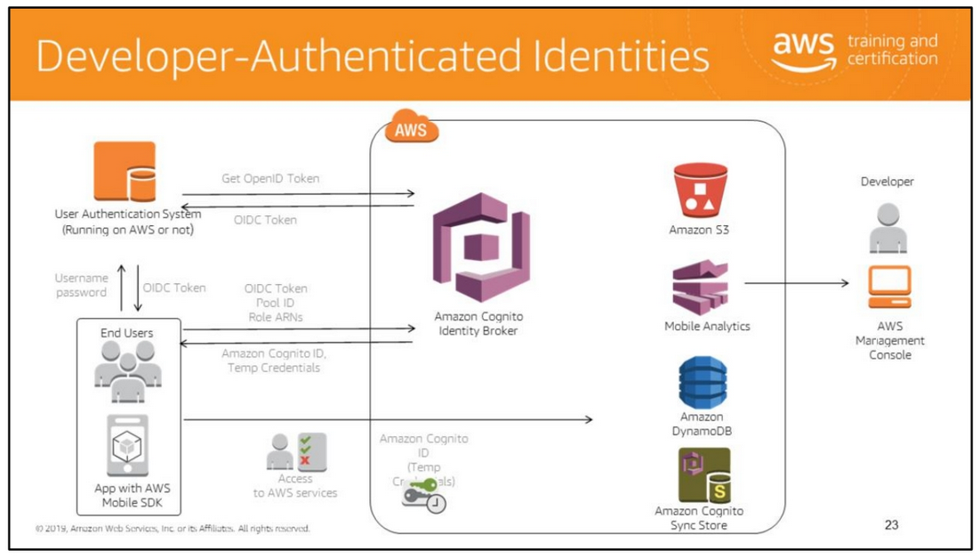
Several application developers prefer to use their own identities instead of public identity providers for authentication.
Amazon Cognito makes it easy for you to accomplish this by using the GetOpenIdTokenForDeveloperIdentity API.
With developer authenticated identities, you can register and authenticate users via your own existing authentication process, while still using Amazon Cognito to synchronize user data
and access AWS resources.
The slide illustrates the authentication flow for developer-authenticated identities.
When using developer-authenticated identities, the client will use a different authflow that includes code outside of Amazon Cognito to validate the user in your own authentication system.
For more details, see:
• https://docs.aws.amazon.com/cognito/devguide/identity/concepts/authentication -flow/
• http://mobile.awsblog.com/post/Tx1YVAQ4NZKBWF5/Amazon-Cognito-Announcing-Developer-Authenticated-Identities

Slide 24


Slide 25
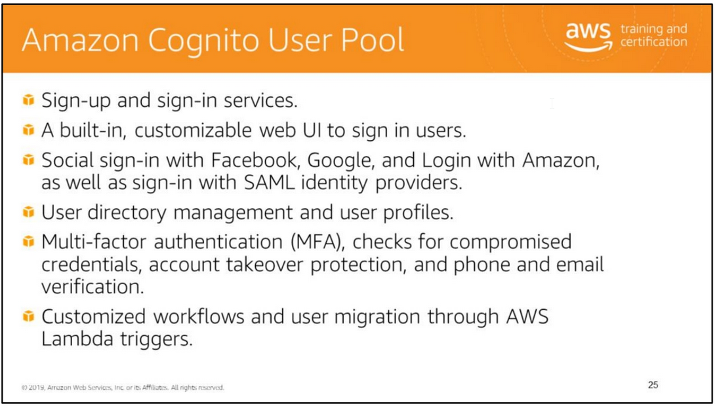
A user pool is a user directory in Amazon Cognito.

Slide 26
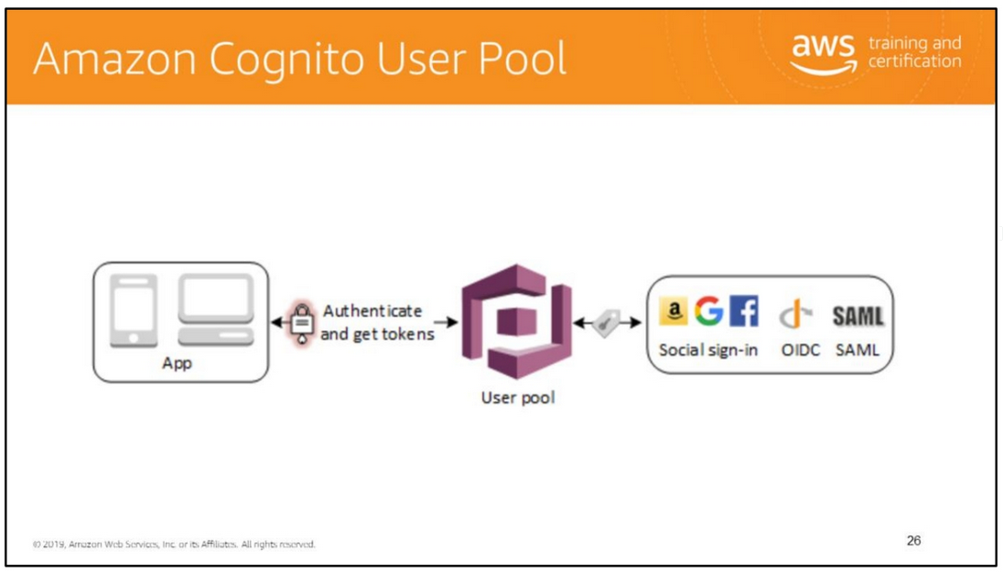
After successfully authenticating a user, Amazon Cognito issues JSON web tokens (JWT) that you can use to secure and authorize access to your own APIs, or exchange for AWS credentials

Slide 27
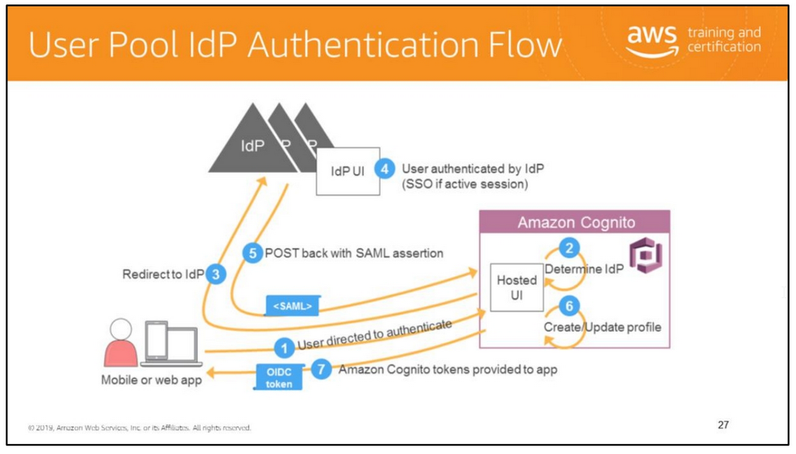
When a user authenticates, the user pool returns ID, access, and refresh tokens.
The ID token is a standard OIDC token for identity management, and the access token is a standard OAuth 2.0 token.
The ID and access tokens expire after one hour, but your app can use the refresh token to get new tokens without having the user re-authenticate.
As a developer, you can choose the expiration time of refresh tokens, and therefore how frequently users need to re-authenticate.
If the user has authenticated through an external IdP (i.e., they are a federated user), your app still uses the Amazon Cognito tokens with the refresh token to determine how long until
the user re-authenticates, regardless of when the external IdP's token expires.
The user pool automatically uses the refresh token to get new ID and access tokens when they expire.
If the refresh token has also expired, the server automatically initiates authentication through the pages in your app that are hosted by AWS

Slide 28

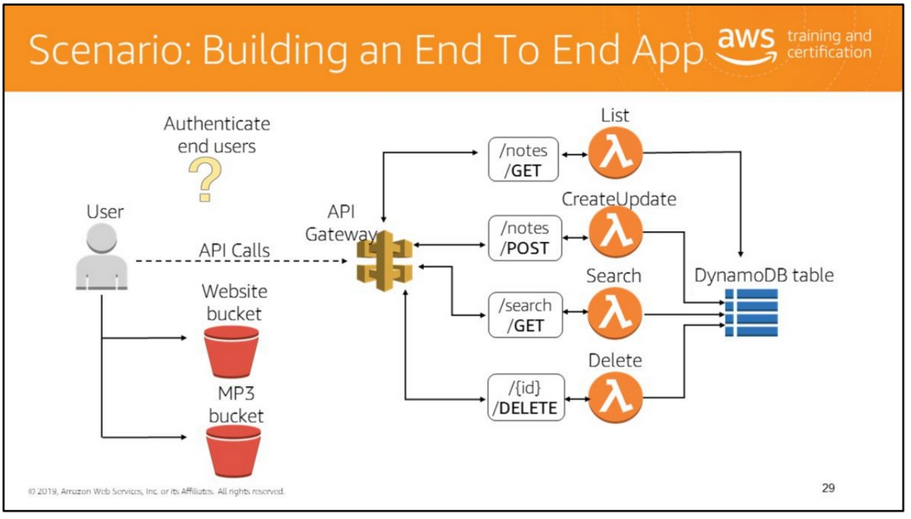
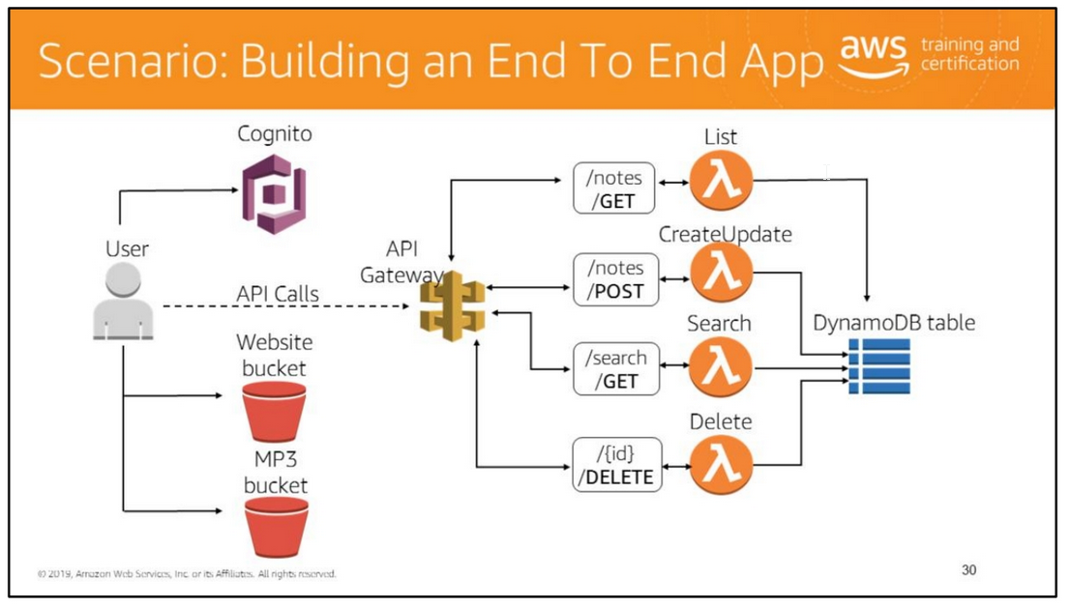
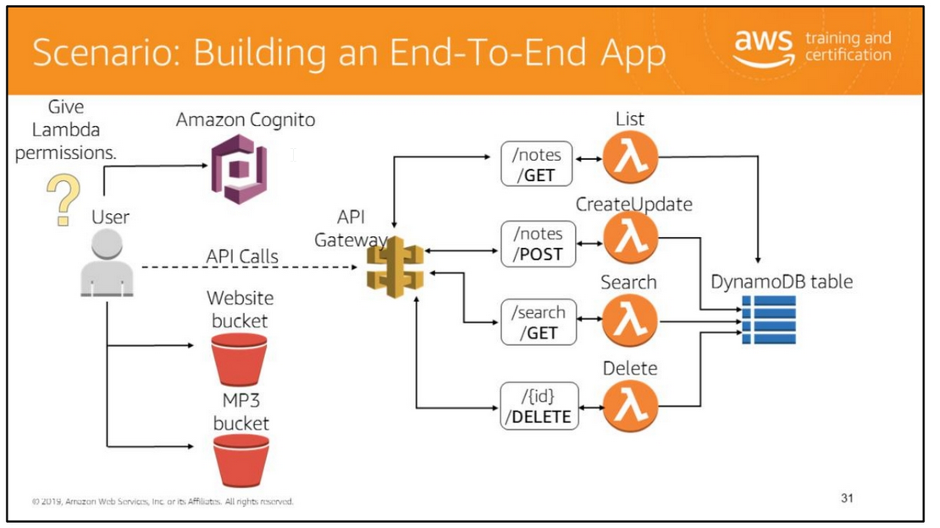
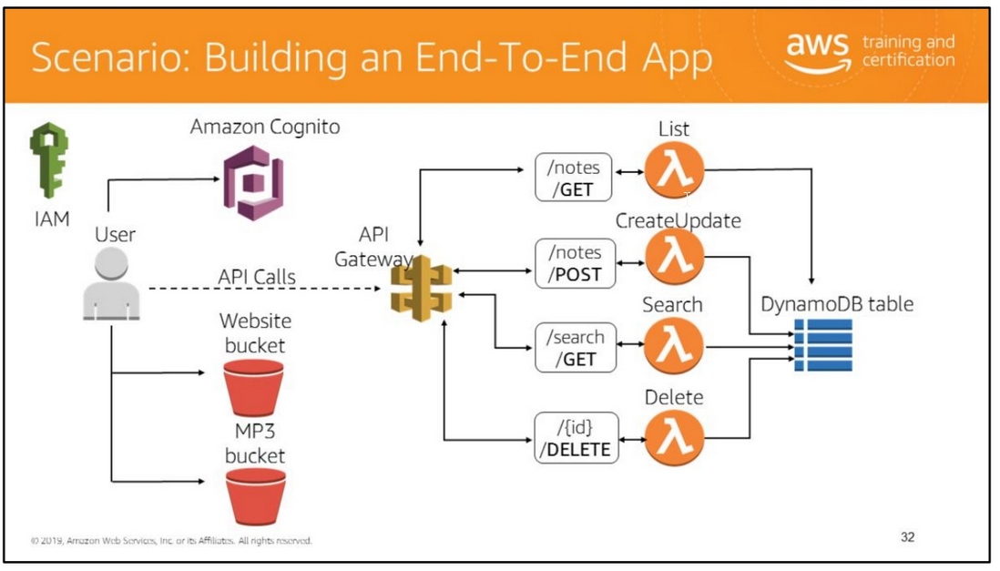

Slide 29

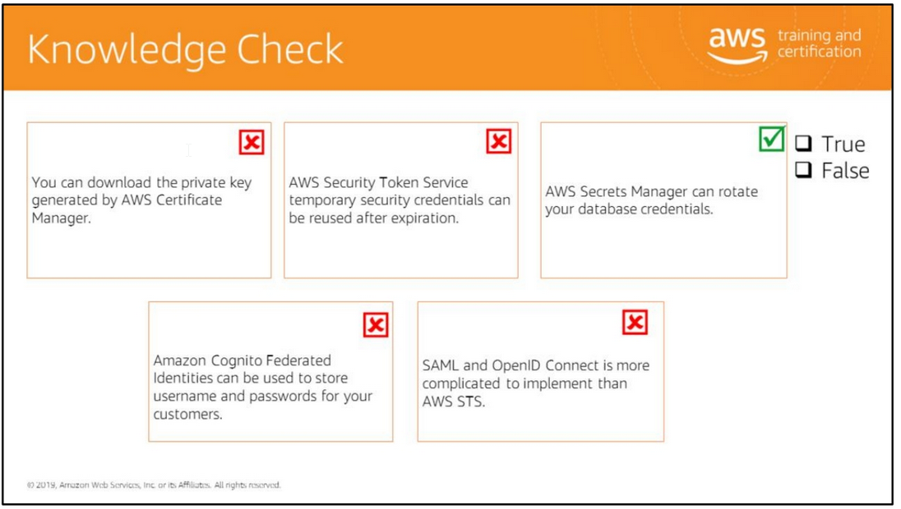
Read left to right:
(False) You can’t download the private key generated by AWS Certificate Manager.
(False) The temporary security credentials have a limited (3600 seconds, by default) and configurable lifetime. You can specify how long the credentials are valid.
After they expire, they cannot be reused.
(True)
(False)
(False)
False)

Slide 30


